Slide 1

Machine Learning Demo
Optimizing a Resource Trading Network
Martin Madsen
Ph.D. in Experimental Physics
16 years’ experience working with sensors, data collection, data analysis, and predictive model building

Slide 2
Scenario: Allocating Resources
Auto
Electric charging stations
Street sweepers
Buses
Fryers
Aircrafts
Surveillance
Vaccine dispensers
Smart meters
Power plant
Cows
Oil equipment
Elevators
Factory floor
Racing
Buildings
Mining equipment
Vending machines
Power tools
Postboxes
Oil distribution
Engines
Medical devices
Dogs
Trucks
Smart grids

Slide 3
Scenario: Allocating Resources
Auto
Electric charging stations
Street sweepers
Buses
Fryers
Aircrafts
Surveillance
Vaccine dispensers
Smart meters
Power plant
Cows
Oil equipment
Elevators
Factory floor
Racing
Buildings
Mining equipment
Vending machines
Power tools
Postboxes
Oil distribution
Engines
Medical devices
Dogs
Trucks
Smart grids

Slide 4
Scenario: Allocating Resources
Auto
Electric charging stations
Street sweepers
Buses
Fryers
Aircrafts
Surveillance
Vaccine dispensers
Smart meters
Power plant
Cows
Swap Items
Oil equipment
Elevators
Factory floor
Racing
Buildings
Mining equipment
Vending machines
Power tools
Postboxes
Oil distribution
Engines
Medical devices
Dogs
Trucks
Smart grids

Slide 5
Scenario: Allocating Resources
Auto
Electric charging stations
Street sweepers
Buses
Fryers
Aircrafts
Surveillance
Smart meters
Dogs
Power plant
Cows
Oil equipment
Elevators
Factory floor
Racing
Buildings
Mining equipment
Vending machines
Power tools
Postboxes
Oil distribution
Engines
Medical devices
Vaccine dispensers
Trucks
Smart grids

Slide 6
Scenario: Allocating Resources
Auto
Electric charging stations
Street sweepers
Buses
Fryers
Aircrafts
Surveillance
Smart meters
Dogs
Power plant
Cows
Oil equipment
Elevators
Factory floor
Racing
Buildings
Mining equipment
Improved Group
Vending machines
Power tools
Postboxes
Oil distribution
Engines
Medical devices
Vaccine dispensers
Trucks
Smart grids

Slide 7
Fixed Resources
Auto
Electric charging stations
Street sweepers
Buses
Fryers
Aircrafts
Surveillance
Smart meters
Dogs
Power plant
Cows
Oil equipment
Elevators
Factory floor
Racing
Buildings
Mining equipment
Vending machines
Power tools
Postboxes
Oil distribution
Engines
Medical devices
Vaccine dispensers
Trucks
Smart grids

Slide 8
Auto
Electric charging stations
Street sweepers
Buses
Fryers
Aircrafts
Surveillance
Resource Mobility
Cost to Transport
Distance to Move
Smart meters
Dogs
Power plant
Cows
Payoff for Moving
Oil equipment
Elevators
Factory floor
Racing
Buildings
Mining equipment
Vending machines
Power tools
Postboxes
Oil distribution
Engines
Medical devices
Vaccine dispensers
Trucks
Smart grids

Slide 9
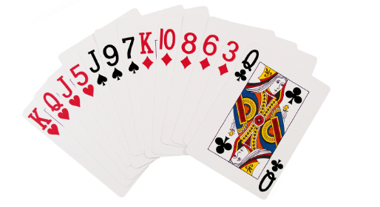
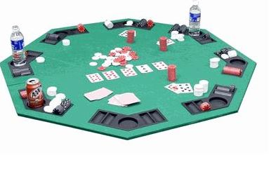
Demonstration Resources
Swap Cards

Slide 10


Use Neural Network to Score Hands
High Card
Pair
Two Pair
Three of a Kind
Straight
Flush
Full House
Four of a Kind
Straight Flush
Royal Flush
0
1
2
3
4
5
6
7
8
9

Slide 11
Poker Hand to Pattern

Slide 12




Poker Hand to Pattern
2 3 4 5 6 7 8 9 T J Q K A
 |  |  | 1
 |  |  | 1 |  |  |  | 1 | 1
1

Slide 13
Poker Hand to Pattern
 |  |  |  |  | 1
 |  |  |  |  | 1 |  |  |  | 1 | 1
 |  | 1
2 3 4 5 6 7 8 9 T J Q K A

Slide 14
Poker Hand to Pattern
 |  |  |  |  | 1
 |  |  |  |  | 1 |  |  |  | 1 | 1
 |  | 1

Slide 15
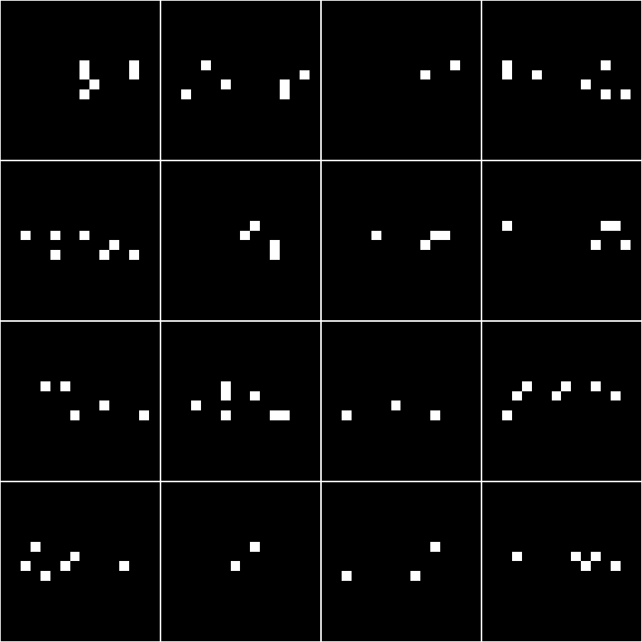
8
K
8
K
2
Q
K
9
J
A
8

Slide 16
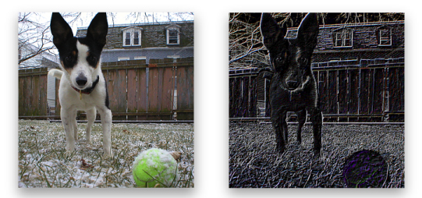
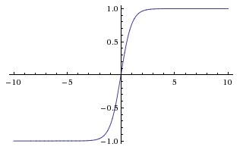

Convolution Neural Network: LeNet (slightly modified)
Data
Convolution Layer: 5x5 kernel
20 filters
Pooling Layer: 2x2 kernel, stride 2
Tanh Activation Layer
Convolution
5x5: 50 filters
Tanh Activation
Pooling 2x2/ 2
Fully Connected
500 Nodes
Flatten
Tanh Activation
Fully Connected
40 Nodes
SoftMax
Output
https://developer.apple.com/library/content/documentation/Performance/Conceptual/vImage/ConvolutionOperations/ConvolutionOperations.html
http://cs231n.github.io/assets/cnn/maxpool.jpeg

Slide 17
Training Data
High Card
Pair
Two Pair
Three of a Kind
Straight
Flush
Full House
Four of a Kind
Straight Flush
Royal Flush
0
1
2
3
4
5
6
7
8
9
3,718,704 unique
5,6, and 7 card hands

Slide 18

Training Data
High Card
Pair
Two Pair
Three of a Kind
Straight
Flush
Full House
Four of a Kind
Straight Flush
Royal Flush
0
1
2
3
4
5
6
7
8
9
Trained 600 Epochs

Slide 19
Testing Data
929,675 unique hands
High Card
Pair
Two Pair
Three of a Kind
Straight
Flush
Full House
Four of a Kind
Straight Flush
Royal Flush
0
1
2
3
4
5
6
7
8
9

Slide 20
Model Test Performance
High Card
Pair
Two Pair
Three of a Kind
Straight
Flush
Full House
Four of a Kind
Straight Flush
Royal Flush
0
1
2
3
4
5
6
7
8
9

Slide 21
Demonstration Resources
Swap Cards

Slide 22
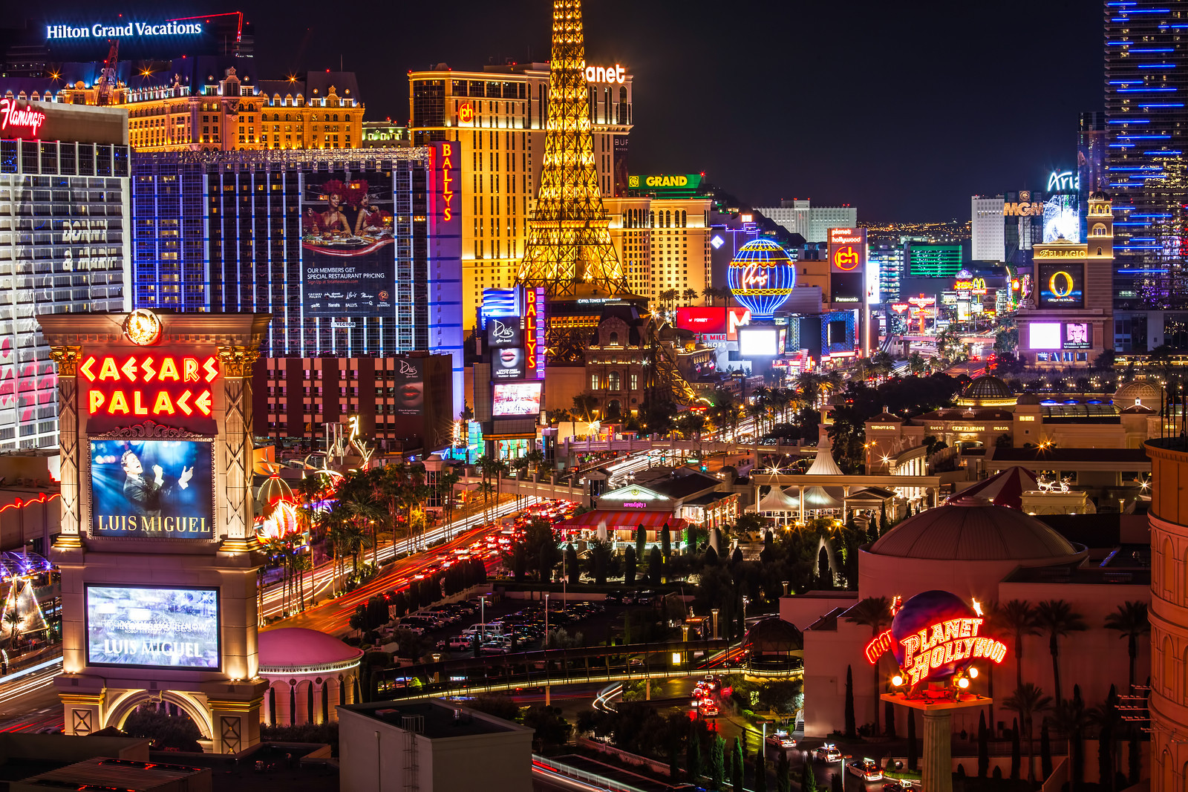
Geography
12 “casinos” in Las Vegas
1 “casino” in Atlantic City
Each “casino” has
3 poker rooms
2 tables in each room
2 hands at each table
https://jamesb.com/wp-content/uploads/2013/11/vegas-business-X3.jpg

Slide 23
Each Card has:
Transportation Cost
Cost of moving the card (per kilometer)
Occupation Level
Very high for “table” cards that cannot be traded

Slide 24
Input Hands
Two pair = 2
High Card = 0
Pair = 1
Two pair = 2
High Card = 0
Straight = 4
Pair = 1
Pair = 1
High Card = 0
High Card = 0

Slide 25
Input Hands
Two pair = 2
High Card = 0
Pair = 1
Two pair = 2
High Card = 0
Straight = 4
Pair = 1
Pair = 1
High Card = 0
High Card = 0

Slide 26
Two Pair
Excalibur
Room 1
Table 1
Hand 2
Straight
California
Room 3
Table 1
Hand 2
Total: 6

Slide 27
Two Pair
Excalibur
Room 1
Table 1
Hand 2
Straight
California
Room 3
Table 1
Hand 2
Total: 6

Slide 28
Two Pair
Excalibur
Room 1
Table 1
Hand 2
Pair
California
Room 3
Table 1
Hand 2
Total: 3 < 6
May or may not
Keep trade
(probabilistic)

Slide 29
Pseudo-Temperature ≈ Probability of keeping “bad” trades

Slide 30
Two Pair
Excalibur
Room 1
Table 1
Hand 2
Straight
California
Room 3
Table 1
Hand 2
Total: 6

Slide 31
Two Pair
Excalibur
Room 1
Table 1
Hand 2
Straight
California
Room 3
Table 1
Hand 2
Total: 6

Slide 32
Full House
Excalibur
Room 1
Table 1
Hand 2
Pair
California
Room 3
Table 1
Hand 2
Total: 7 > 6
Likely to keep trade

Slide 36
Input Hands
Two pair = 2
High Card = 0
Pair = 1
Two pair = 2
High Card = 0
Straight = 4
Pair = 1
Pair = 1
High Card = 0
High Card = 0

Slide 37
Output Hands
Two pair = 2
Straight = 4
Two Pair = 2
Full House = 6
Full House = 6
Flush = 5
Flush = 5
Full House = 6
Straight = 4
Pair = 1

Slide 38
Summary
 |  |  |  |  | 1
 |  |  |  |  | 1 |  |  |  | 1 | 1
 |  | 1
2 3 4 5 6 7 8 9 T J Q K A

Slide 39
Summary
 |  |  |  |  | 1
 |  |  |  |  | 1 |  |  |  | 1 | 1
 |  | 1
2 3 4 5 6 7 8 9 T J Q K A

Slide 40
Summary
 |  |  |  |  | 1
 |  |  |  |  | 1 |  |  |  | 1 | 1
 |  | 1
2 3 4 5 6 7 8 9 T J Q K A
Swap Cards

Slide 41
Summary
 |  |  |  |  | 1
 |  |  |  |  | 1 |  |  |  | 1 | 1
 |  | 1
2 3 4 5 6 7 8 9 T J Q K A
Swap Cards

Slide 42
Thank You!
Questions, comments, or further conversation:
Martin John Madsen
https://www.linkedin.com/in/martinjohnmadsen
Notes:
[Josh’s Slide]

